Slide 1
An Association Network for Computing Semantic Relatedness
Keyang Zhang
Shanghai Jiao Tong University
keyangzh@gmail.com
Joint work with Kenny Zhu and Seung-won Hwang
To appear at AAAI 2015

Slide 2
What Is Association
A connection between concepts in the mind or imagination
Associate from A to B: from A we can think of B
  river -> water, lake, boat
  car -> drive, engine

Slide 3
Overview
Semantic Relatedness Computation
Related Work
Association Network
  Free Association Network
  Synthetic Association Network
Experimental Results

Slide 4
Overview
Semantic Relatedness Computation
Related Work
Association Network
  Free Association Network
  Synthetic Association Network
Experimental Results

Slide 5
Semantic Relatedness
Between two language units A and B
  Terms
  Sentences
  Documents
Semantically how much A has to do with B
More general than semantic similarity
  river & lake
  river & boat

Slide 6
Real-world Applications
Semantic search
  Results ranking
Machine translation
Text classification
Text summarization
...

Slide 7
Relatedness Computation Tasks
Ground truth
  Scored by several people, then average
Criterion: correlation with ground truth
  Pearson
  Spearman
Two tasks we aim to solve
  Term
  Sentence (short text)

Slide 8
Term Relatedness
Term1 | Term2 | Score
car | automobile | 8.94
car | train | 6.31
car | drink | 3.04

Slide 9
Sentence Relatedness
Sentence1 | Sentence2 | Score
I am so hungry I could eat a whole horse plus dessert. | I could have eaten another meal, I'm still starving. | 3.06
Flies can also carry a lot of disease and cause maggots. | I dry my hair after I wash it or I will get ill. | 0.12

Slide 10
Overview
Semantic Relatedness Computation
Related Work
Association Network
  Free Association Network
  Synthetic Association Network
Experimental Results

Slide 11
Related Work
Taxonomy based
  WordNet
  Only good at similarity, rely on human efforts
Corpus based
  Rely on statistics counted from large corpus
  Latent Semantic Analysis

Slide 12
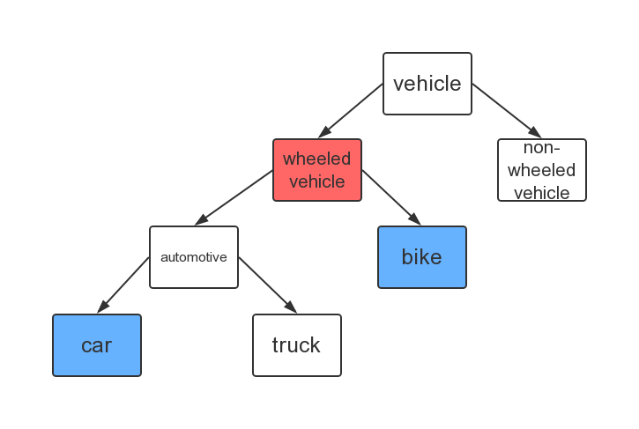
WordNet

Slide 13
Related Work
Taxonomy based
  WordNet
  Least common subsumer
  Only good at similarity, rely on human efforts
Corpus based
  Rely on statistics counted from large corpus
  Latent Semantic Analysis

Slide 14
Overview
Semantic Relatedness Computation
Related Work
Association Network
  Free Association Network
  Synthetic Association Network
Experimental Results

Slide 15
Overview
Semantic Relatedness Computation
Related Work
Association Network
  Free Association Network
  Synthetic Association Network
Experimental Results

Slide 16
Free Association
A technique used in psychoanalysis
Given a cue word, produce the first word that comes to mind as response
Several collections of data called free association norms

Slide 17
Free Association Norms
Cue | Response | Strength
river | lake | 15/150
river | stream | 15/150
river | water | 9/150
river | flow | 8/150
river | boat | 7/150
river | canoe | 7/150

Slide 18
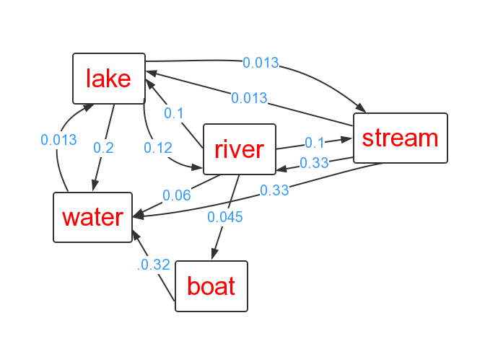
Free Association Network

Slide 19
Relatedness Computation
Baseline algorithm
Bridge vertices
Limitations
  Small lexical coverage (5,000 vertices)
  Sparse (70,000 edges)

Slide 20
Free Association Network

Slide 21
Relatedness Computation
Baseline algorithm
Bridge vertices
Limitations
  Small lexical coverage (5,000 vertices)
  Sparse (70,000 edges)

Slide 22
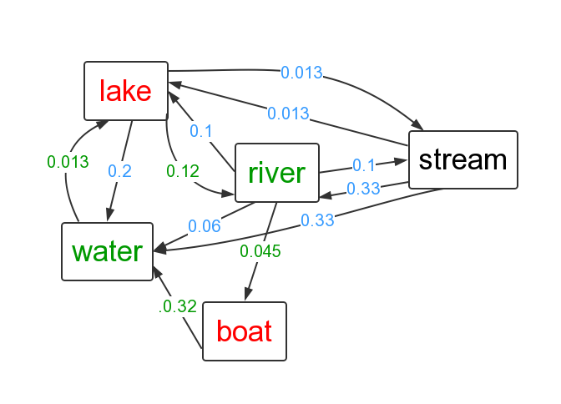
Bridge Vertices

Slide 23
Relatedness Computation
Baseline algorithm
Bridge vertices
Limitations
  Small lexical coverage (5,000 vertices)
  Sparse (70,000 edges)

Slide 24
Overview
Semantic Relatedness Computation
Related Work
Association Network
  Free Association Network
  Synthetic Association Network
Experimental Results

Slide 25
Synthetic Association Network
Based on 5 types of co-occurrences from Wikipedia
Use free association network for training
Overcome limitations of free association network

Slide 26
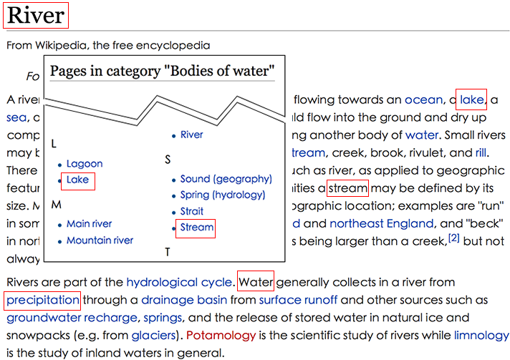
5 Types of Co-occurrences

Slide 27


5 Types of Co-occurrences

Slide 28
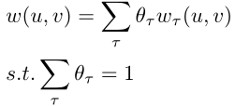

Weights Training
Weighted sum (linear combination)
Linear regression
  Instances: term pairs in free association
  Features: five types of
  Label: strength from free association network

Slide 29
Overview
Semantic Relatedness Computation
Related Work
Association Network
  Free Association Network
  Synthetic Association Network
Experimental Results

Slide 30
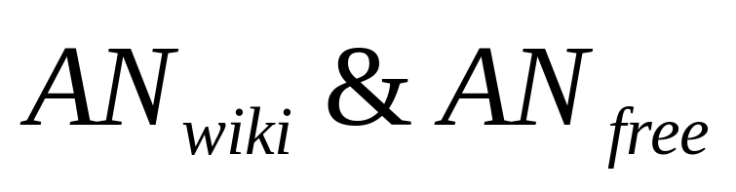
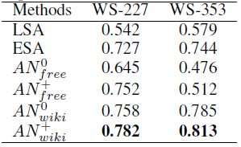

Slide 32
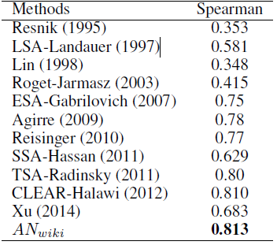
Term Relatedness

Slide 33
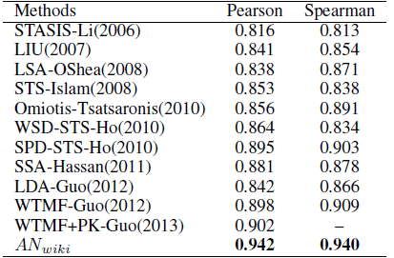
Sentence Relatedness

Slide 34
Dataset
The dataset of our association network is availale at:
http://adapt.seiee.sjtu.edu.cn/~keyang/assoc

Slide 35
Thanks!

